Slide 1
2010 ACM Athena Lecture
Shared Caches in Multicores
Mary Jane Irwin
Computer Science & Engr.
Penn State University
Summer 2010

Slide 2

The ACM Athena Lectures
Athena is the Greek goddess of wisdom. The ACM Athena Lectures were designed by ACM-W to “celebrate women researchers who have made fundamental research contributions to computer science.” Lecturers are nominated by ACM SIGs.
There have been five awarded to date: Deborah Estrin (‘06), Karen Sparck Jones (‘07), Shafi Goldwasser (‘08), Susan Eggers (‘09), and me (‘10)

Slide 3
The forces at work
 | 2010 | 2012 | 2014 | 2016 | 2018
Tech node (nm) | 32 | 22 | 16 | 11 | 8
Integ capacity (BT) | 16 | 32 | 64 | 128 | 256
The Power Wall
The Technology
Multicores
Keep on performance curve

Slide 4
The multicore revolution
Multiple cores on one chip (socket) are the norm
But … the other on-chip resources used by those cores must also scale
  On-chip storage (e.g., caches)
  Core interconnect
  Off-chip memory bandwidth (e.g., memory controllers)
Performance also depends upon the design and effective management of these other resources
Improving the performance of on-chip caches in multicores

Slide 5
Multicore “A”
Core1
Core2
Core3
Core4
L1 I
L1D
L1 I
L1D
L1 I
L1D
L1 I
L1D
L2
L2
L2
L2
Examples – AMD’s AthlonX2, IBM’s POWER6
  Good: Fast interconnect; No L2 app thread contention
    Good for multiprogrammed (single-threaded apps) workloads
  Bad: App threads can’t share L2 capacity . . . or data

Slide 6
Multicore “B”
Core1
Core2
Core3
Core4
L1 I
L1D
L1 I
L1D
L1 I
L1D
L1 I
L1D
L2
L2
Again, many examples – e.g., Intel’s CoreDuo
  Good: App threads can share L2 data … and capacity
    Good for multi-threaded (parallel apps) workloads
  Bad: Slower interconnect; L2 app thread contention

Slide 7
When app contention is an issue
Apps can be characterized as to their last level cache (LLC) behavior
Devils and rabbits – Xie and Loh (CMP-MSI’08)
  Devil apps do not “play well with others” - access LLC very frequently, but still have a high miss rate (low reuse)
  Rabbit apps need “more space to run around in” - access the LLC fairly frequently and have a low miss rate if they have a sufficient number of LLC ways allocated to them, otherwise their performance degrades rapidly

Slide 8
Architectural “solutions”
Keep the devil apps from harming the rabbit apps by dynamically “partitioning” the shared LLC
  Regency position dynamic partitioning – Suh, et.al. (HPCA’04)
  Utility-based cache partitioning (UCP) – Qureshi and Patt (MICRO’06)
  Cooperative cache partitioning (CCP) – Chang and Sohi (ICS’07)
  Thread-aware dynamic insertion (TADIP) – Jaleel, et.al (PACT’08)
  . . .

Slide 9
More architectural “solutions”
Or to dynamically “share” the capacity of private LLCs
  Cooperative caching – Chang and Sohi (ISCA’06)
  Distributed cooperative caching – Herrero, et.al. (PACT’08)
  . . .
Or to try to have the best of both worlds with a LLC that can be private, shared or some of both
  Elastic cooperative caching – Herrero, Gonzalez, Canal (ISCA’10)
  . . .

Slide 10
Observations about multi-threaded applications

Slide 11
Multi-threaded app’s (SPEComp)
Simulation (Simics): 8 cores, 8 threads, 2MB shared L2
Inter-core misses are on average double that of Intra-core misses

Slide 12
Another key observation
Most of these inter-core misses are from a few distinct memory address (hot blocks)

Slide 13
Yet another observation
Most hot blocks (64.5%) are accessed over and over again within 100 references
So “pin” these hot blocks in the LLC and have another place to put the references from other cores that map to those pinned sets

Slide 14
Set pinning
Srikantaiah, et.al (ASPLOS’08)
Cores get replacement ownership of L2 sets by pinning them in place (core_id becomes part of the cache tag)
  Inter-core miss from non-owner cores are stored in that core’s small (e.g., 16KB) POP (Privately Owned Processor) cache
Core₁
Pinned
L2
cache
Core₂
Core₃
Core₄
POP₁
  Can improve performance by periodically relinquishing ownership (some threads are too greedy)
POP₂
POP₃
POP₄

Slide 15
Performance benefits
Adaptive set pinning reduces L2 miss rate by 48% on average and improves performance by 18% on average

Slide 16
Multi-threaded app’s structure
Start Parallel Section
T 1
T 1
T 2
T 2
T 3
T 3
T 4
T 4
critical path thread
End Parallel Section

Slide 17
Multi-threaded app’s (SPEComp, NAS)
Simulation (Simics): 4 cores, 4 threads, 1MB shared L2
An app’s thread’s performance is largely determined by its LLC cache behavior
So dynamically partition the LLC to give the critical path thread more ways

Slide 18
Critical path thread cache partitioning
Muralidhara, et.al. (IPDPS’10)
Improves performance by up to 23% (11% avg) over equal partitions, 15% (9% avg) over non-partitioned, and 20% (10% avg) over throughput partitioned

Slide 19
Lately multicore architectures have gotten even more interesting ...

Slide 20
More cores per socket
Multicore “H”
C1
C2
C3
C4
C5
C6
C7
C8
L1 I
L1D
L1 I
L1D
L1 I
L1D
L1 I
L1D
L1 I
L1D
L1 I
L1D
L1 I
L1D
L1 I
L1D
L2
L2
L2
L2
H is for Intel’s Harpertown – with 8 cores
Note the pair shared L2’s

Slide 21
More cache levels
Multicore “N”
C1
C2
C3
C4
C5
C6
C7
C8
L1 I
L1D
L1 I
L1D
L1 I
L1D
L1 I
L1D
L1 I
L1D
L1 I
L1D
L1 I
L1D
L1 I
L1D
L2
L2
L2
L2
L2
L2
L2
L2
L3
L3
N is for Intel’s Nehalem – again with 8 cores
Three cache levels, private L2s, socket shared L3s

Slide 22
More of both
Multicore “D”
C1
C2
C3
C4
C5
C6
C7
C8
C9
CA
CB
CC
L1 I
L1D
L1 I
L1D
L1 I
L1D
L1 I
L1D
L1 I
L1D
L1 I
L1D
L1 I
L1D
L1 I
L1D
L1 I
L1D
L1 I
L1D
L1 I
L1D
L1 I
L1D
L2
L2
L2
L2
L2
L2
L3
L3
D is for Intel’s Dunnington – with 12 cores
Three cache levels, pair shared L2s, socket shared L3s

Slide 23
Multi-threaded app’s
Consider running a single, multi-threaded application on N (or H or D)
C1
C2
C3
C4
C5
C6
C7
C8
L1 I
L1D
L1 I
L1D
L1 I
L1D
L1 I
L1D
L1 I
L1D
L1 I
L1D
L1 I
L1D
L1 I
L1D
L2
L2
L2
L2
L2
L2
L2
L2
L3
L3

Slide 24
Food for thought
It is highly likely code optimized for N won’t run well on H (or D) and vice versa
  Multi-threaded application (galgel) optimized for the cache hierarchy of each architecture
  Running code optimized for H on N gives a 26% performance hit

Slide 25
Iteration-to-core mapping – data sharing
0
1
2
3
0
1
2
3
B
B
B
B
B
B
B
Iterations i and j which both access B are mapped to cores that do not share an L2
Missed opportunity
Iterations i and j which both access B are mapped to cores that share an L2
Constructive data sharing

Slide 26
Local iteration scheduling
0
1
0
1
A
B
B
C
B
A
B
C
Iterations of core0 access A while core1 access B (core1 loads 1st ); the later access to B by core0 is a miss
Missed opportunity
Iterations of core0 are rescheduled so that access to B by core0 is now a hit
Constructive data sharing

Slide 27
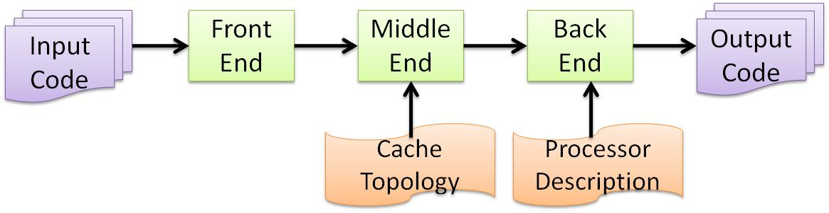
Compilation “solution”
Kandemir, et.al. (PLDI’10)
Developed a compiler based, cache-topology aware thread mapper and scheduler
  Iteration-to-core mapping (assign iterations to cores)
  Local (per core) iteration scheduling
Microsoft’s Phoenix Compiler Infrastructure (code analyzer), polyhedral framework iteration and data sets (PSU) -> Omega Library -> iterations assigned to the cores, Intel compiler back end

Slide 28
Performance improvements
Harpertown – 28% and 16% over Base, Base+
Nehalem – 29% and 17% over Base, Base+
Dunnington – 30% and 21% over Base, Base+

Slide 29
But most multicores are likely to be running both multithreaded and single-threaded apps at the same time

Slide 30
A laptop, desktop scenario
Have both thread contention and thread sharing
C1
C2
C3
C4
C5
C6
C7
C8
L1 I
L1D
L1 I
L1D
L1 I
L1D
L1 I
L1D
L1 I
L1D
L1 I
L1D
L1 I
L1D
L1 I
L1D
L2
L2
L2
L2
L2
L2
L2
L2
L3
L3

Slide 31

And have to deal with thermal emergencies
C1
C2
C3
C4
C5
C6
C7
C8
L1 I
L1D
L1 I
L1D
L1 I
L1D
L1 I
L1D
L1 I
L1D
L1 I
L1D
L1 I
L1D
L1 I
L1D
L2
L2
L2
L2
L2
L2
L2
L2
L3
L3

Slide 32
And have to deal with faults
SEU, aging, … where cores have to be decommission (and possibly recommissioned)
C1
C2
C3
C4
C5
C6
C7
C8
L1 I
L1D
L1 I
L1D
L1 I
L1D
L1 I
L1D
L1 I
L1D
L1 I
L1D
L1 I
L1D
L1 I
L1D
L2
L2
L2
L2
L2
L2
L2
L2
L3
L3

Slide 33
Such scenarios require an approach that can reschedule threads at run time

Slide 34
Run-time “solutions”
The OS can optimize thread scheduling on multicores at runtime – for performance, for power, for reliability
  Arch support for OS cache management – Rafique, et.al. (PACT’06)
  OS page allocation – e.g., Cho, et.al. (MICRO’06)
  Thread scheduling for constructive cache sharing – e.g., Chen, et.al., (SPAA’07)
  Cache-fair scheduling – Fedorova, et.al. (PACT’07)
  Cache contention-aware thread scheduling – e.g., Zhuravlev, Blagodurov, Fedorova (ASPLOS’10)
  . . .

Slide 35
REEact: A Virtual Exec Manager with Soffa & Davidson (UVA), Childers (UPitt)
Support Services
Multi app mapping policy
Thread monitor
OS
Global Execution Manager
Core Temp Info
Compiler thread mapping policy
Critical thread mapping policy
Perfmon
Application Execution Manager
Application Execution Manager
VEM Communicator
Thermal alarm policy
Software Profiler
Core Execution Manager
Core Execution Manager
Core Execution Manager
Core Execution Manager

Slide 36
Mapping with REEact (PARSEC)
Yorkfield: 4 cores, 4 threads/app, 6MB pair-shared L2
Applications
  StreamCluster (memory-bound)
  BodyTrack (I/O-bound)
  Swaptions (CPU-bound)
  CaNneal (memory-bound)
  FLuidanimate (memory-CPU- bound)
Static isolation mapping
app1 on core0 and core1
app2 on core2 and core3
Dynamic mapping
Core load balancing and utilization

Slide 37
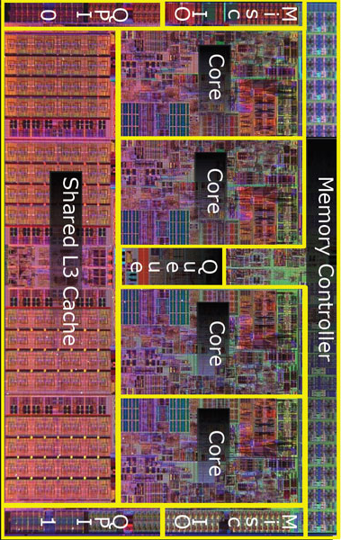
In closing – it takes a village
Other issues
  Cache coherence
  Memory bandwidth mgmt
  Network-on-chip impacts
  Impacts of 3D and new technologies
Explicitly parallel codes (MPI, Cilk, TBB, cuda, pthreads, …)
Architecture aware parallelizing compilers
Identify
the parallel threads
Mapping (scheduling) threads to cores
Initial thread mapping
Dynamically adapting thread-to-core mapping during execution
Run-time thread adaptation
© Intel

Slide 38
Thanks to SIGARCH (and SIGDA)
My career journey
  Decade (or so) working in application specific architectures
SIGARCH
ISCA
SIGARCH S/T
  Decade (or so) working on EDA tools, from logic synthesis, to module layout … to power simulators (SimplePower)
SIGDA
DAC, ISLPED
SIGDA Board
  Decade (or so) back in the architecture space … optimize power, performance, and reliability
SIGARCH
ISCA, ASPLOS
SIGARCH Board
And to ISCA and ACM-W and Google

Slide 39
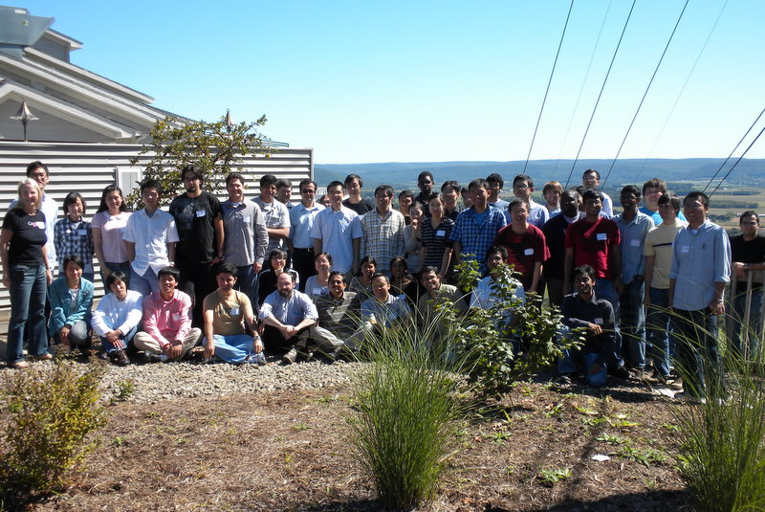
Thanks to my research colleagues
The faculty: Bob Owens, Mahmut Kandemir, Vijay Narayanan, Padma Raghavan, and Yuan Xie (PSU), Jack Davidson and Mary Lou Soffa (UVA), Bruce Childers (UPitt)
(Some of) the students:

Slide 40




Thank you!
Questions?

