Slide 1
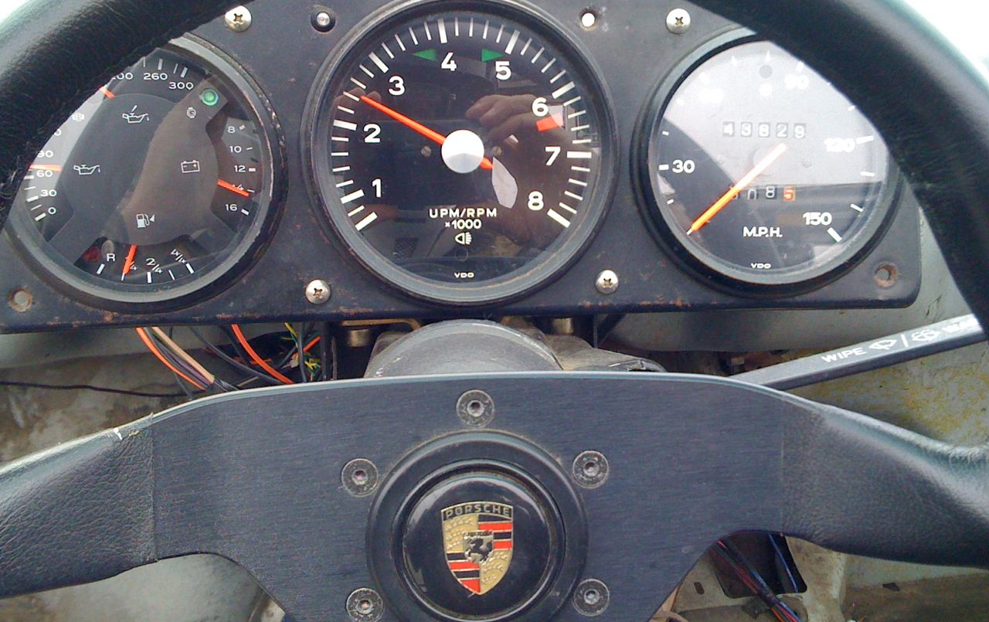
Moving the Needle
Computer Architecture Research
in Academe and Industry
Bill Dally
Chief Scientist & Sr. VP of Research, NVIDIA
Bell Professor of Engineering, Stanford University

Slide 2
Outline
The Research Funnel
  Most ideas fail
  Those that succeed take 5-10 years
The Research Formula
Constraints
The Academic Advantage
The Industrial Advantage
Startups
Best practices

Slide 3
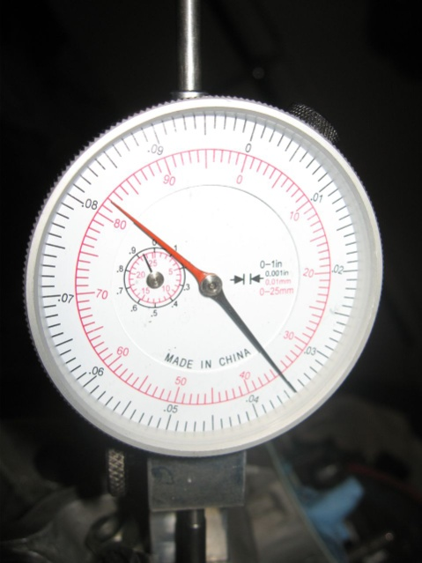
Goal – Positive Impact on a Product

Slide 4
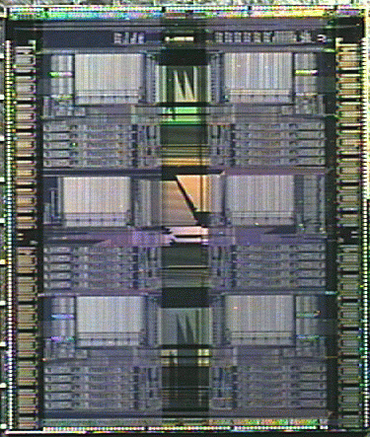

The Research Funnel
Technology
insight
Concept
Dev
Model
Eval
Dev
Applications

Slide 5
Most ideas fail
The ideas that succeed take a long time
Concept
Dev
Model
Eval
Dev

Slide 6
Most ideas fail
The ideas that succeed take a long time
Concept
Dev
Model
Eval
Dev

Slide 7
Most ideas fail
So terminate the bad ones quickly

Slide 8
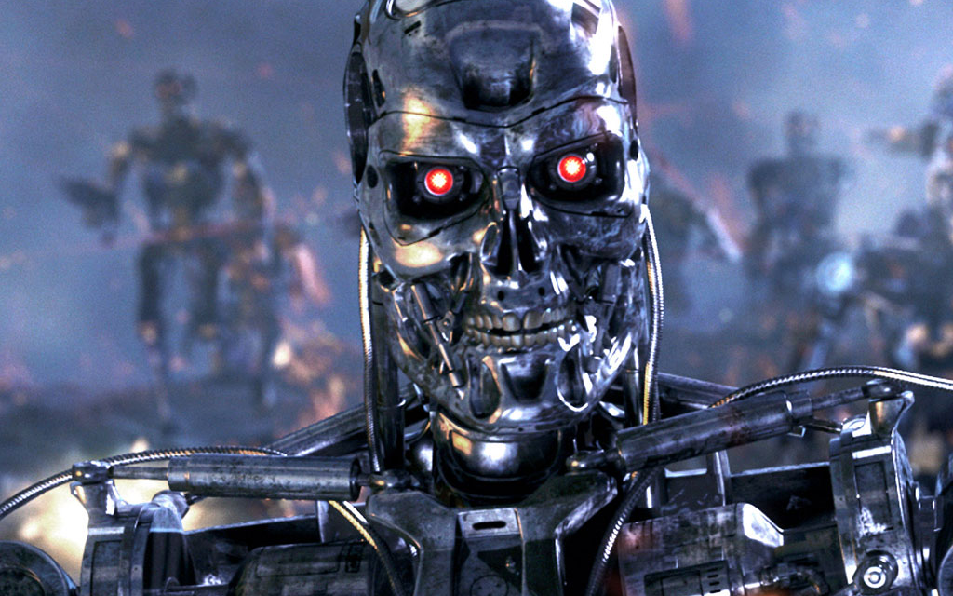
Most ideas fail
So terminate the bad ones quickly
Be a terminator, not an advocate

Slide 9
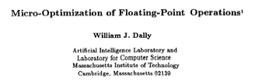
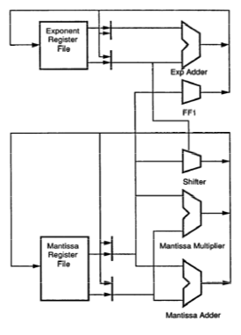
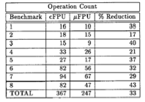
Dally, “Micro-Optimization of Floating-Point Operations, ASPLOS, 1989, pp 283-289

Slide 11
Most ideas fail
The ideas that succeed take a long time
Concept
Dev
Model
Eval
Dev

Slide 12
The ideas that succeed take a long time
So aim research 5-10 years ahead of current practice

Slide 13

Current Architecture Practice

Slide 15
Aim Here
5-10 years

Slide 16
Enable this point
5-10 years

Slide 17
Timeline for some ideas
Idea | Concept | Published | Product | ΔT
Stream Processing | 1995 | 1998 | 2006 | 11
Virtual Channels | 1985 | 1990 | 1992 | 7
Equalized Signaling | 1995 | 1996 | 2000 | 5
High-Radix Networks | 2002 | 2005 | 2008 | 6

Slide 18
The Performance Equation

Slide 19
The Research Formula

Slide 20
Reward
If you are wildly successful, what difference will it make?

Slide 21
Effort
Learn as much as possible with as little work as possible

Slide 22
Effort
Do the minimum analysis and experimentation necessary to make a point

Slide 23
Real and Artificial Constraints
Real Constraints | Artificial Constraints
Laws of physics Future semiconductor processes Packaging and thermal limits Future applications | Existing ISA Existing OS Today’s benchmarks Existing compilers Infrastructure

Slide 24
Constraining Infrastructure
Benchmarks
Binaries
Compiler
uArch Idea
Simulator
ISA
Other
uArch

Slide 25
Constraining Infrastructure
Benchmarks
Binaries
Compiler
Simulator
ISA
uArch Idea
Other
uArch

Slide 26
Constraining Infrastructure
Benchmarks
Binaries
Compiler
uArch Idea
Simulator
ISA
Other
uArch

Slide 27
The contribution is insight
Not novelty
Not numbers

Slide 28
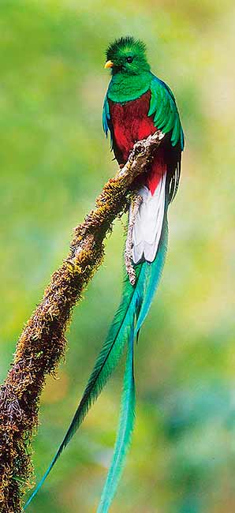
Research is a
hunt for insight
Need to get off the beaten path to find new insights

Slide 29
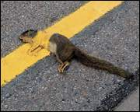
Road-Kill Research
Benchmarks
Compiler
Binaries
uArch Idea
Simulator
ISA
Other
uArch

Slide 30


Slide 31
Looking here for lost keys

Slide 32
Lost keys here
Looking here

Slide 33
The Academic Advantage

Slide 34
The Academic Advantage
Freedom

Slide 35
The Academic Advantage
Freedom from artificial constraints
Freedom to fail (take risks)

Slide 36
Academic research matched for early stages of the funnel
Concept
Dev
Model
Eval
Dev

Slide 37
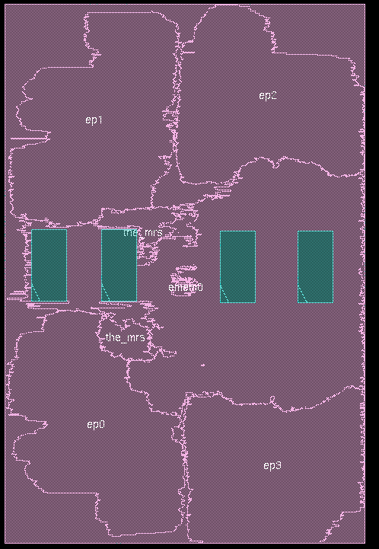
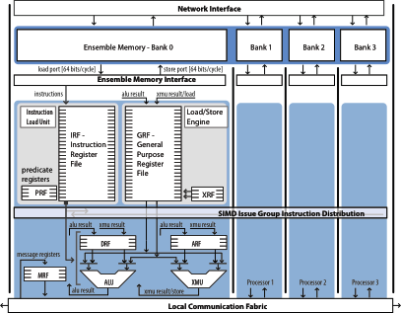
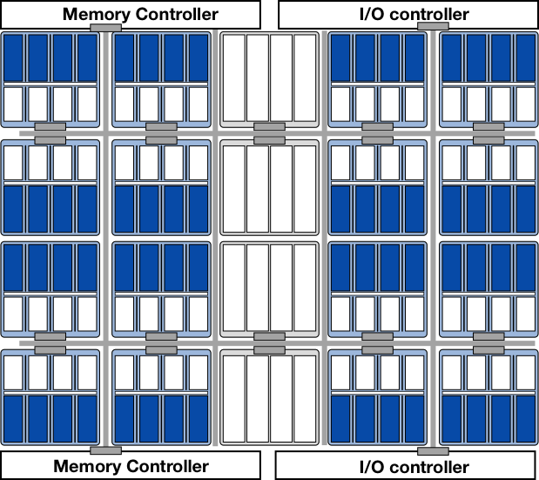
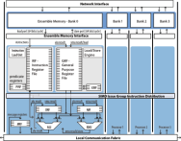
Example: ELM
An Ensemble
Many Ensembles and memory tiles on a die

Slide 38
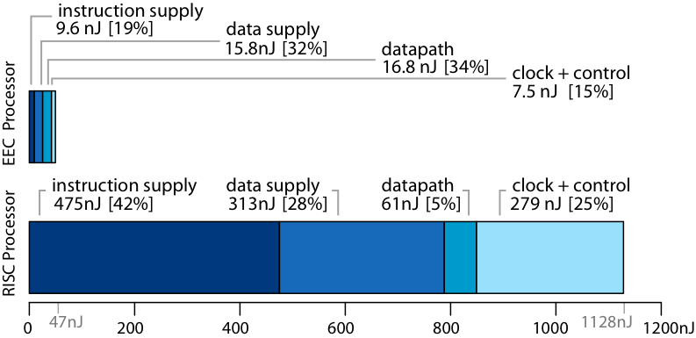
Example: ELM
Balfour et al., "An Energy-Efficient Processor Architecture for Embedded Systems" CAL, Jan. 2008, pp 29-32.

Slide 39

ELM Infrastructure
Benchmarks
Binaries
Compiler
uArch Idea
Simulator
ISA
Other
uArch
Changed for ELM

Slide 40
The Industrial Advantage
Resources and Experience

Slide 41
The Industrial Advantage
Resources to carry out detailed studies
Experience to address commercial constraints

Slide 42
The ideal partnership:
Academic research 5-10 years out, focused on industry problems
Transfer insight to industrial research to refine into product
Concept
Dev
Model
Eval
Dev

Slide 43
What transfers is insight
Not academic design
Not performance numbers

Slide 44
What transfers is insight
And its transferred by people
Not papers

Slide 45
Academic
Concept
Analysis
Simulation
Prototype
Refine Concept
Detailed Design
Industrial

Slide 46
Academic
Industrial
Gap
Concept
Analysis
Simulation
Prototype
Refine Concept
Detailed Design
Paper
Impact

Slide 47
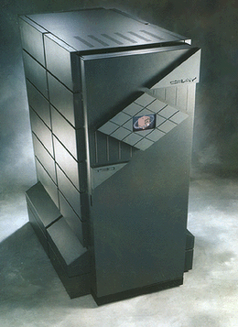
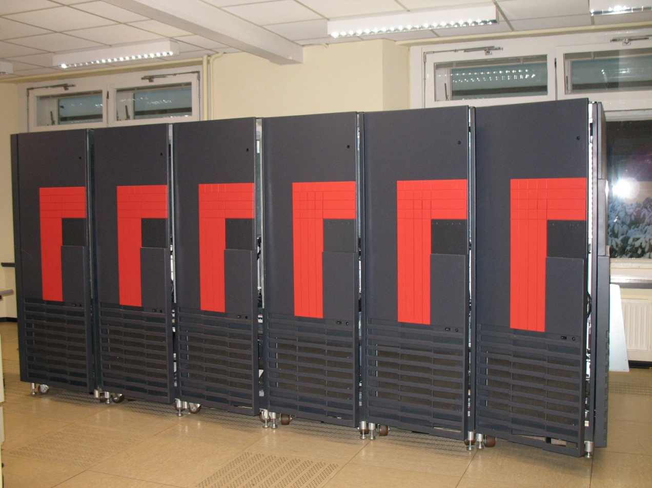
Example: Cray T3D and T3E

Slide 48
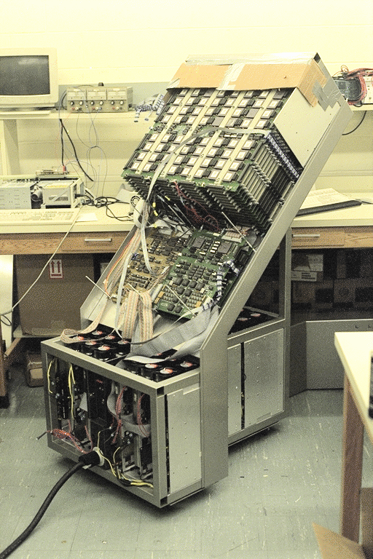
J-Machine
MIT 1987-1992
3-D network
Global address space
Fast messaging and synchronization
Support for many models of computation

Slide 49
Cray T3D
Started working with Cray in 1989
Project started early 1990
First ship in mid 1992
From J-Machine
  Network
  Fast communication/sync
  Global address space
For reality
  Alpha processors
  MECL gate arrays
  Robust software stack

Slide 50
Best Practices for Academics
Long-term perspective (5-10 years)
  Know your customer and their long-term issues
  Look at tomorrow’s applications, not yesterdays
Maximize reward, minimize effort
  Estimate maximum impact – terminate…
  Minimal analysis and experiment to make the point
Exploit your freedom
  Don’t be limited by exiting tools, benchmarks, ISAs, …
Carry result to impact
Build relationships with industry
Benchmarks
Compiler
Binaries
ISA
uArch Idea
Simulator
Other
uArch

Slide 51
Best Practices for Industry
Leverage academic research
  Build partnerships
  Articulate long-term research issues
  Be open-minded
Minimize artificial constraints
Carry concepts across “the gap”
Open infrastructure

Slide 52
A Partnership
Filtered, De-risked Concepts
Academe
Industry
Future issues
Infrastructure

Slide 53
The Startup Path
When you can’t find an appropriate industrial partner, make one.
STAC, Avici, Velio, SPI

Slide 54
Academic
Concept
Analysis
Simulation
Prototype
Refine Concept
Detailed Design
Startup

Slide 55
Startup Pros/Cons
Pros
Cons
Don’t have to convince existing company to change course (until exit)
Have to convince investors (repeatedly)
Have to build a whole company, not just a development team
  Finance, sales, marketing, …
Limited resources
Impatient capital

Slide 56

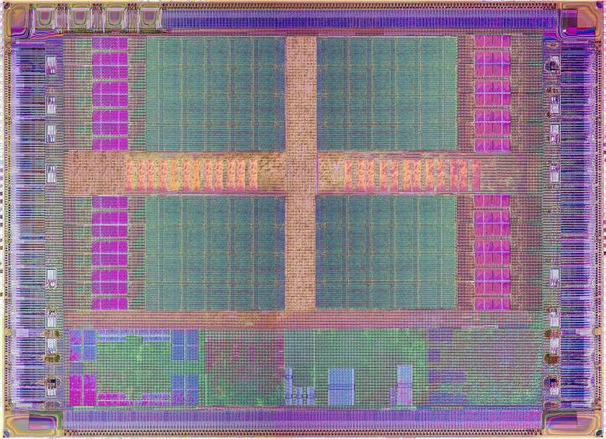
Example: SPI
Date | Event
Jan 2004 | SPI Incorporated
Nov 2004 | First round financing
April 2006 | Tapeout Storm-1
Oct 2006 | First ship of Storm-1
2007 | Software, software, software
2008 | Customers in production
Sept 2009 | Doors close

Slide 57
Much easier to license technology to an existing company

Slide 58
Starting a company to bring a new semiconductor product to market costs $30M (to cash flow positive)
If it’s a programmable processor, its $70M
Investors want a 10x ROI
Need to see a $700M exit to justify a new processor company

Slide 59
The future of computer architecture

Slide 60
The future of computer architecture
NOW is an ideal time for research to move the needle
Computers are drastically changing
  Pervasive parallelism
  Energy limited
  Bandwidth constrained
Opportunity to set the MSB of future computers in the next few years
Requires changing the whole stack
Requires industry-academe partnership

Slide 61
Energy-Efficient Architecture
Abstracting Locality
20mm
7pJ
2000pJ
50pJ
500pJ
L3
Net
L2
Net
2000pJ
L1
L1
L1
L1
P
P
P
P
Notes:
Corner to corner (32mm) is 16FLOPs
Off chip is 20 FLOPS
Corner to corner is 200 MACs, off chip is 250
Off chip is

Slide 62
Solution involves many levels of the “stack”
Application
Algorithm
Prog. System
Compiler
ISA
uArch
Too constrained to innovate within one layer
Design
Circuits
Process

Slide 63

Academe
Benchmarks
Compiler
Binaries
Industry
ISA
uArch Idea
Simulator
Other
uArch

Slide 64
Moving the Needle
Computer Architecture Research
in Academe and Industry
Bill Dally
Chief Scientist & Sr. VP of Research, NVIDIA
Bell Professor of Engineering, Stanford University

