Slide 1
La microarchitecture est morte. Longue vie à la microarchitecture!
(Microarchitecture is dead.
Long live microarchitecture!)
ISCA 2010 Panel, St. Malo, France
Mark D. Hill, Moderator | Univ. of Wisconsin-Madison
Stephen W. Keckler | Nvidia & Univ. of Texas at Austin
Christos E. Kozyrakis | Stanford Univ.
Mark H. Oskin | Univ. of Washington
Yale N. Patt | Univ. of Texas at Austin
Burton J. Smith | Microsoft
Charles P. Thacker | Microsoft Research
Notes:
LogTM: Log-based Transactional Memory
2010-4-26
UW-Madison Architecture Seminar
1

Slide 2
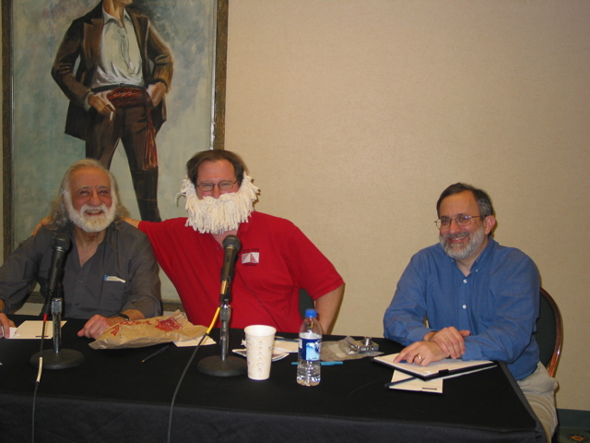
HPCA 2007 Debate [IEEE Micro 11-12/2007]
Amdahl’s Law and the Multicore Era [Computer 7/2008]
  Software F parallel & 1-F sequential
  Base core 1 resource → 1 performance
  Enhanced core R resources → performance
  N resources per chip → N/R symmetric cores

Slide 3
Speedup for Symmetric Multicore Chips
Fraction Parallel:
90%
99%
100%
16 Base Cores
7
14
16
256 Base Cores
27
80
256
➔ Concentrate on Increasing Parallelism!

Slide 4
Optimal Core Size for Symmetric Multicore Chips
Asymmetric
Fraction Parallel:
90%
99%
100%
16 Base Cores
2
1
1
118
41
1
256 Base Cores
28
3
1
➔ Concentrate on Core Design!

Slide 5
Trends in Core Microarchitecture Research
Credit Dan Gibson; Blame Mark Hill, 6/2010
5
Notes:
LogTM: Log-based Transactional Memory
4/26/2010
UW-Madison Architecture Seminar
5

Slide 6
La microarchitecture est morte. Longue vie à la microarchitecture!
(Microarchitecture is dead.
Long live microarchitecture!)
ISCA 2010 Panel, St. Malo, France
Mark D. Hill, Moderator | Univ. of Wisconsin-Madison
Stephen W. Keckler | Nvidia & Univ. of Texas at Austin
Christos E. Kozyrakis | Stanford Univ.
Mark H. Oskin | Univ. of Washington
Yale N. Patt | Univ. of Texas at Austin
Burton J. Smith | Microsoft
Charles P. Thacker | Microsoft Research
Notes:
LogTM: Log-based Transactional Memory
2010-4-26
UW-Madison Architecture Seminar
6

