Slide 1


Η Μικροαρχιτεκτονική Πέθανε.
Ζήτω η Μικροαρχιτεκτονική!
EU-required translation to Greek
Christos Kozyrakis
Stanford University
http://csl.stanford.edu/~christos
Panel at ISCA – June 2010

Slide 2
What is Microarchicture?
New apps (physics, graphics, AI/ML,…),
new use cases (mobile, cloud, …),, security, parallelism, programmability, …
Energy, manufacturability, reliability, new memory & communication tech, …
Architecture
Design
Microarchitecture
Will change radically along with arch & design!
Pipelining, branch prediction, OOO logic,…

Slide 3
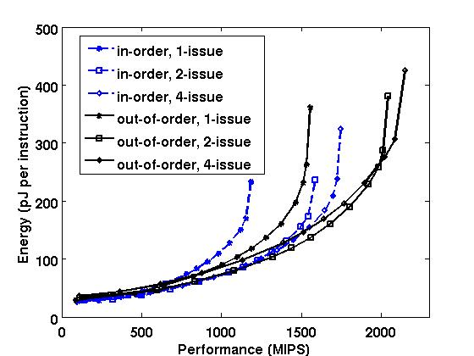
Business as Usual? Not an Option!
[Azizi et al, ISCA’10]
Systematic study of uarch, circuits, and DVFS
The space of (energy) efficient uarchs is small!
2-issue in-order
2-issue ooo

Slide 4
Still Lots of Untapped Efficiency
[Hameed et al, ISCA’10]
Study of programmable cores Vs ASIC for H.264
Data parallelism is a big improvement; embrace it…
Simply scaling #, type, and details of cores is not enough…
Need to rethink instruction & data fetch to reach ASIC efficiencies.
Can we maintain programmability?
Notes:
4

Slide 5
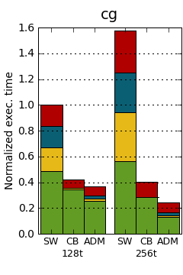
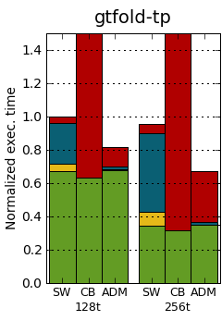
We Can even Help with Admahl’s Law
[Sanchez et al, ASPLOS’10]
ISA+uArch support for scheduling fine-grain tasks
  Using reg-to-reg messages that trigger user-level exceptions
  Every else is software (queues & scheduling algorithm)
Keeping HW simple is cheaper and faster…
What are the basic ISA+uarch primitives for parallelism?
5x faster than SW scheduling
App
Queues
Stealing
Starved
31x
26x

Slide 6
So is Microarchitecture Dead?
No, but it’s not the king either!
It’s a democracy with 3 government braches
  Architecture ↔ Microarchitecture ↔ Design
Lots of exciting opportunities ahead
  If we work across all 3 of them
Greek: δημοκρατία (origin)
French: démocratie

Slide 7
Backup Slides
Differences from Steve
Differences from Yale
Sensitivity to panelists’ order
Uarch can stop the oil spill
Live World Cup feed
Intimidating technical issue #6
OMG, they killed Kenny
Who is Keyzer Soze
Talking cat on Youtube
The meaning of life

